Slide 1
MARS DL version 4.6 custom mips simulator with github intergration DUC LE DEC 12 2025

Slide 2
What is MARS DL 4.6?
A custom enhanced version of the MARS MIPS simulator
Built-in GitHub integration (Sign In, Upload, Download)
Ability to browse/create repos from inside MARS
Automatically opens downloaded files in new tabs
Double-click runnable application (no installation needed)

Slide 3

Custom Demon Slayer Instruction Set
10+ custom MIPS-like instructions
Inspired by:
1)Water Breathing
2)Thunder Breathing
3)Sun Breathing
4)Beast Breathing
5)Nezuko Art
Implemented in Java as new MARS DL opcodes
Instructions modify registers, memory, or game-style stats (HP, stamina)

Slide 4
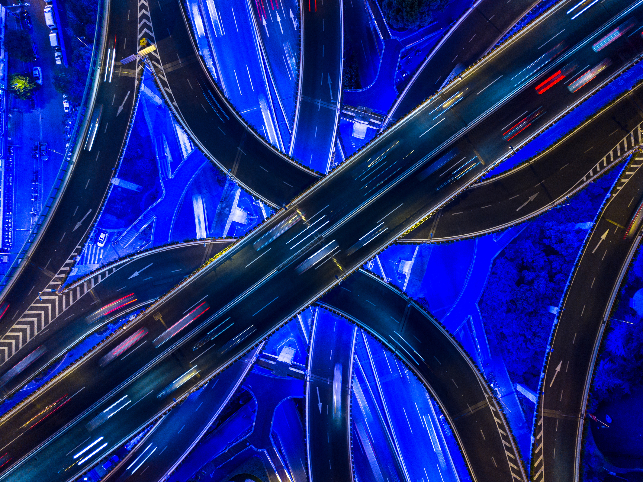
GitHub Integration Demo
Device Login Oauth authentication
Upload flow: select file -> pick repo->commit & push
Download flow: pick repo → branch → file → open in editor tab
Greatly simplifies student workflow for assignments
Works directly with: https://github.com/KphStar/MARS-DL

Slide 5
Conclusion / Q&A
Fully functional MARS DL build
Customizable assembler + runtime
Supports Demon Slayer ISA
Real GitHub integration inside a MIPS IDE
Questions?

